Slide 1
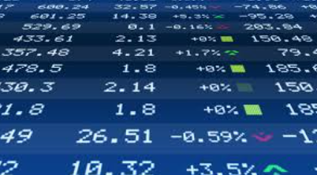

Project 4 Group 2
Drew Bollinger, Nate Savage, Frenci De La Cruz, Nikki Alfrey
Notes:
Nikki

Slide 2
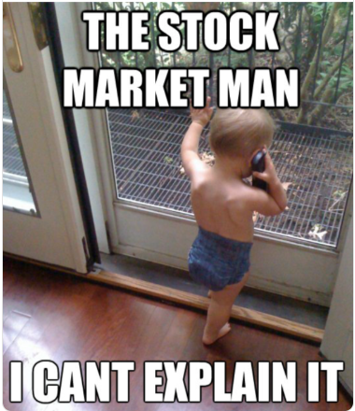
Project 4 – Stock Predictability
Stock market - What you need to know
Strategies for choosing our dataset (Alpaca API)
Data cleaning methods
Buying and Selling Signals
Methods for modeling - Classification
Logistic Regression
Clustering
Random Forest Classifier
Support Vector Machine
Results
Next steps
Notes:
Drew – Introduce our topic, talk through that we will discuss stock market and what someone might need to know about it. Explain how we chose our data set – Alpaca – then how we cleaned the API – We focused on S&P 500, and then landed with Vanguard (VOO), And Explain what are buying and selling signals – How we looked at the 50 and 200 day moving average. Then talk through the methods that we used, that we’ll discuss results and then our next steps.

Slide 3
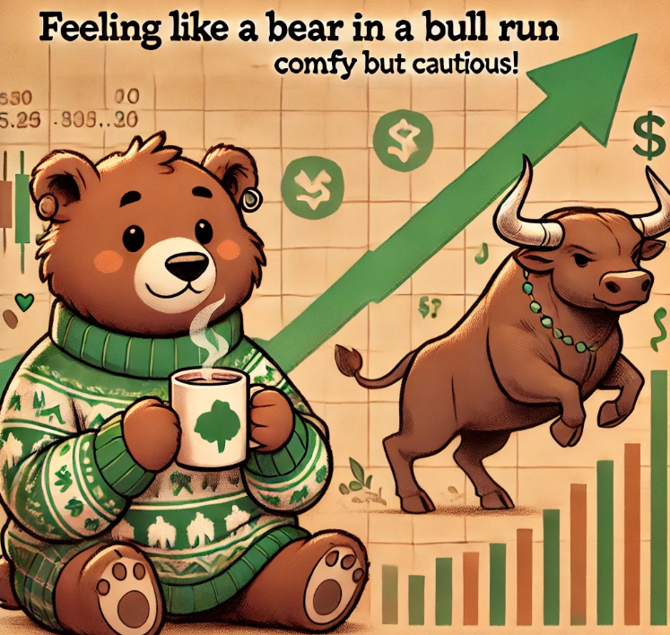
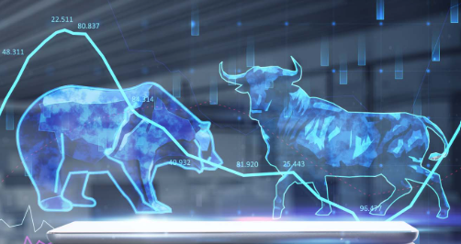
Stock Market – What you need to know
Terminology and High-Level Detail
Terminology
Ticker
Date
Open
High
Low
Close
Volume
Bullish
Bearish
Detail
S&P 500 vs volatile stock
Stock trading day-to-day
Moving Average
Signals to Buy/Sell
Risk Tolerance/Mitigation
Notes:
Drew – Talk through some of the terminology we will be using as we go through the presentation.

Slide 4
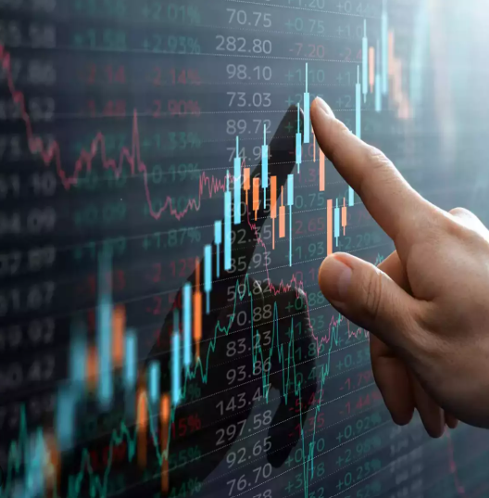
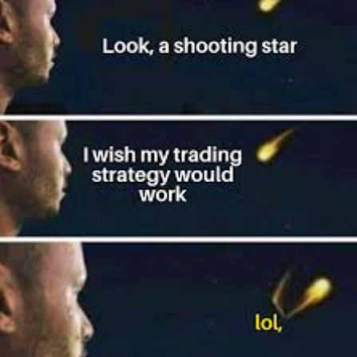
Buying and Selling Signals
How do you know when to buy and sell a stock?
Focused look at Vanguard (VOO)
Moving 50-day and 200-day averages
Bearish vs. Bullish
Predictability
2021 to 2025
Notes:
Nate – Talk through how do you know to buy and/or sell a stock – this was a main reason for choosing this subject and our question that we wanted answered. We focused on a stable S&P stock Vanguard – we looked at the 50/200 day average and the bullish/bearish days and tried to come up with the predictability of the last 4 years of stock close prices. We removed 2020 and earlier due to the historical data being so large – and COVID years affected the stock market extremely.

Slide 5
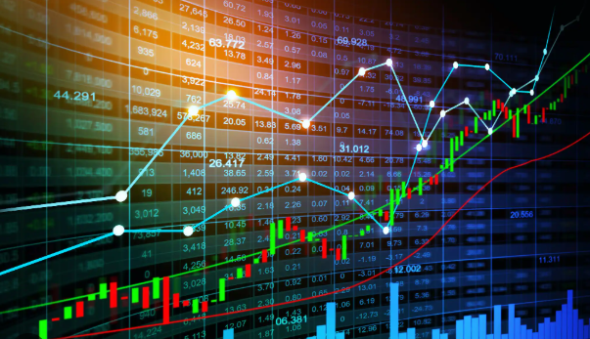
Classification Models
Methods for modeling - Classification
Logistic Regression
Labels created were referencing features which we set – No machine learning
Clustering
Looked at data that was set and compared positive and negative moving averages – did not answer whether to buy/sell
Random Forest Classifier
Accuracy continuously changed, and was not higher than 60%
Support Vector Machine
Accuracy was 1 – stating it was always accurate, which is not the case.
We figured out how to make one million dollars on the stock market, invest two million.
Notes:
Nikki I will talk thought each of the steps we went through trying to get to our end model and/or answer – which we weren’t really able to find an answer.

Slide 6
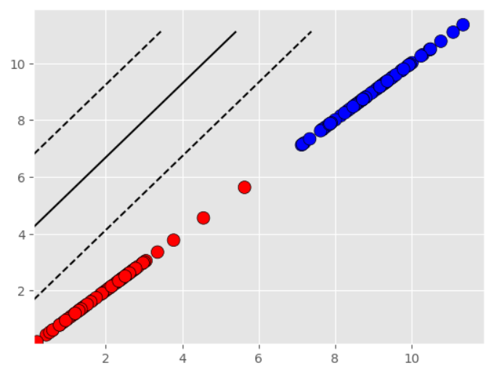
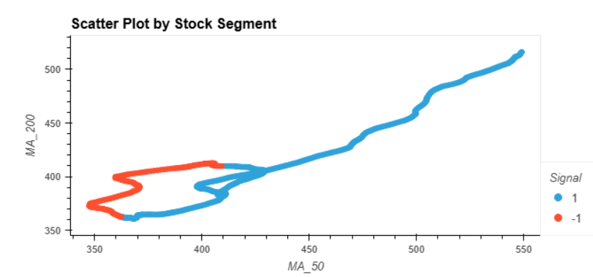
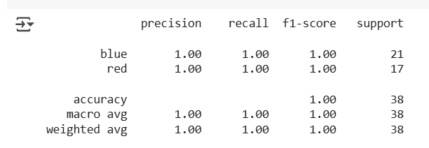
Classification Models
SVM
Clustering
Notes:
Nikki I will talk thought each of the steps we went through trying to get to our end model and/or answer – which we weren’t really able to find an answer.

Slide 7
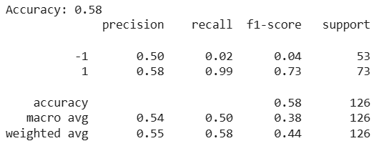
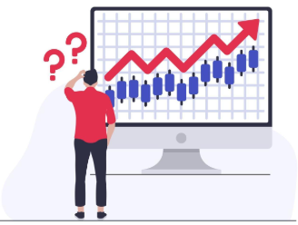
Classification Models
Random Forest Classifier
Notes:
Nikki I will talk thought each of the steps we went through trying to get to our end model and/or answer – which we weren’t really able to find an answer.

Slide 8
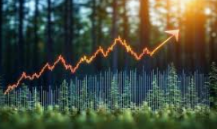
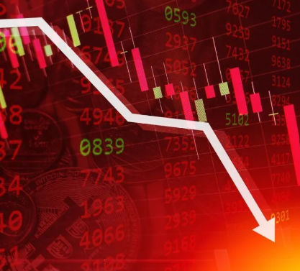
Results/Conclusion
Model Type | Accuracy
Logistic Regression | 1.0
Cluster | ?
Random Forest Classifier | .58
SVM | 1
Notes:
Frenci –

Slide 9
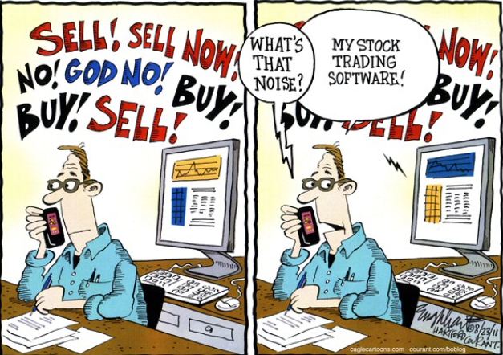
Next Steps
Thoughts to improve our method(s):
Logistic Regression we could look at creating the right labels that would identify features of the stock market to better predict buy/sell signals
Clustering could look at improvements of aligning where the tool might think the next days close price might be
Random Forest Classifier could use different date changing sets, and eliminate random selection to create a more linear look at the data, and fluctuations of a stock
Support Vector Machine work through the plotting of the data to ensure that the code is correctly looking at the right features and data from the Alpaca API
Notes:
Nate – We can change the wording on this

Slide 10

Questions?

Slide 11
Citation(s)
Dataset: Alpaca API

